Slide 1
Representing Word Meaning with Vectors
Chris Callison-Burch
University of Pennsylvania
https://cis.upenn.edu/~ccb/

Slide 2
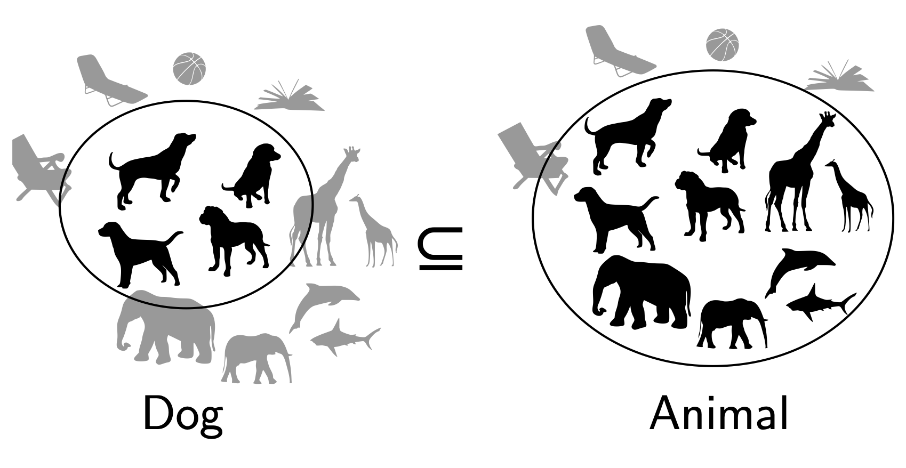
Entailment in formal semantics

Slide 3
Entailment in formal semantics
All animals have an ulnar artery
⇒
All dogs have an ulnar artery
+ Mathematically well-understood + Powerful machinery for handling logical operations
- Knowledge must come from somewhere else

Slide 4
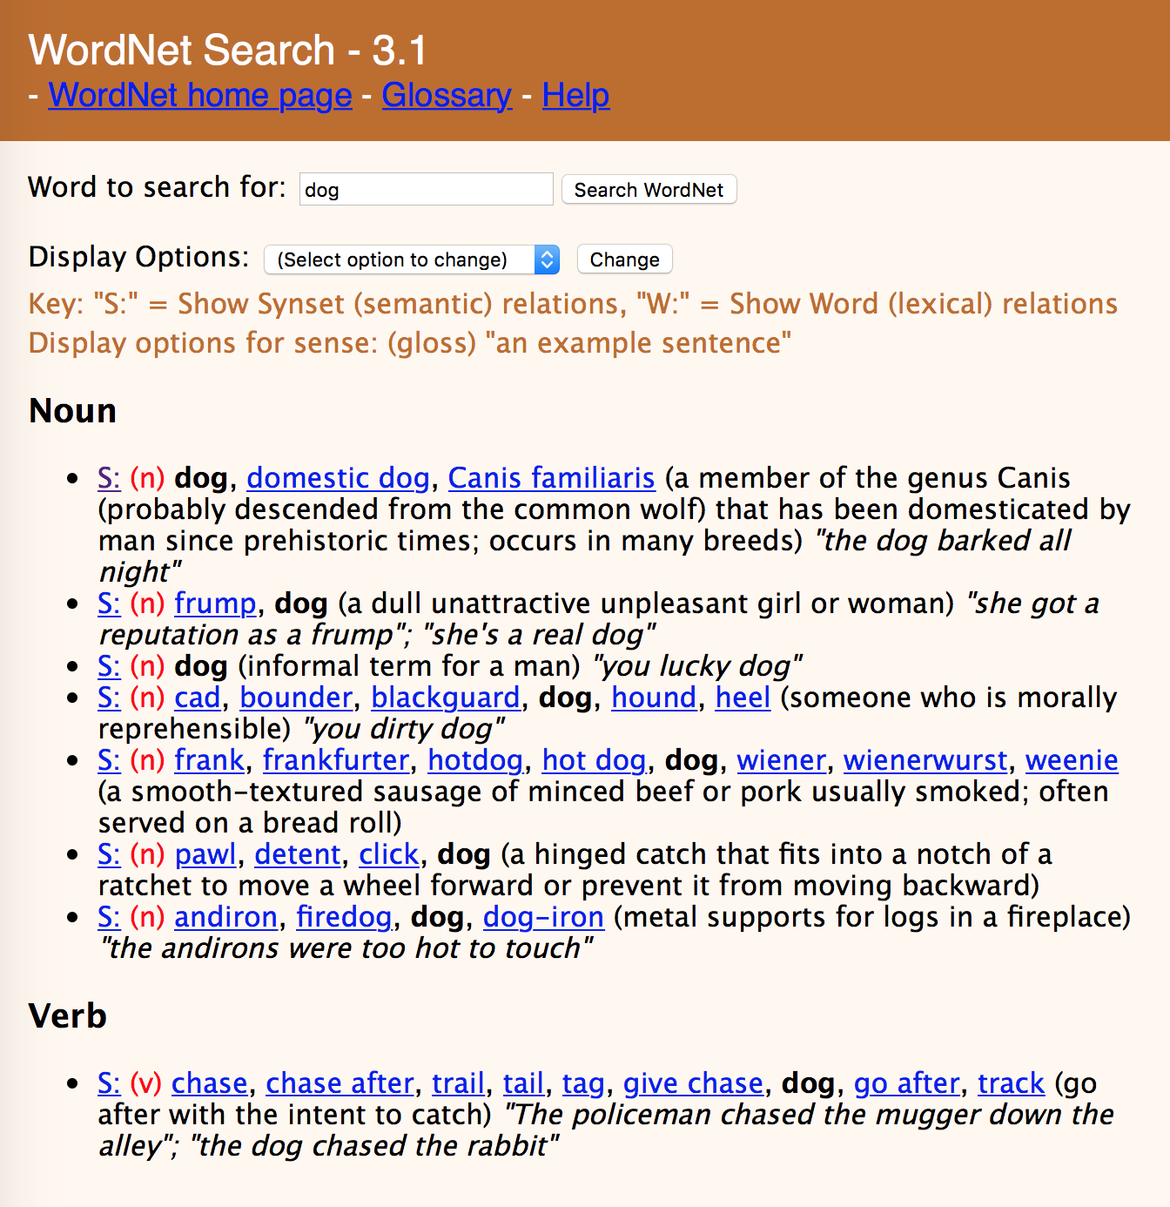

Slide 7
Lexical Semantics
act
communicate
perform
address
relay
practice
harangue
talk about
walk through
scrimmage
rant
descant
WordNet

Slide 8
Lexical Semantics
act
communicate
perform
address
relay
practice
harangue
talk about
walk through
scrimmage
rant
descant
WordNet
Vector Space Models
Notes:
VSMs have several attractive properties. VSMs extract knowledge automatically from a given corpus, thus they require much less labour than other approaches to semantics, such as hand-coded knowledge bases and ontologies.

Slide 9
Vector Space Models
Notes:
The idea of the VSM is to represent each word as a point in a space (a vector in a vector space). Points that are close together in this space are semantically similar and points that are far apart are semantically distant.

Slide 10
Why vector models of meaning? computing the similarity between words
“fast” is similar to “rapid”
“tall” is similar to “height”
Useful for applications like Question Answering

Slide 11
Why vector models of meaning? computing the similarity between words
“fast” is similar to “rapid”
“tall” is similar to “height”
Useful for applications like Question Answering

Slide 12
Why vector models of meaning? computing the similarity between words
“fast” is similar to “rapid”
“tall” is similar to “height”

Slide 13
Why vector models of meaning? computing the similarity between words
“fast” is similar to “rapid”
“tall” is similar to “height”

Slide 14
Intuition of distributional word similarity
Nida (1975) example: A bottle of tesgüino is on the table Everybody likes tesgüino Tesgüino makes you drunk We make tesgüino out of corn.
From context words humans can guess tesgüino means an alcoholic beverage like beer
Intuition for algorithm: Two words are similar if they have similar word contexts.

Slide 15
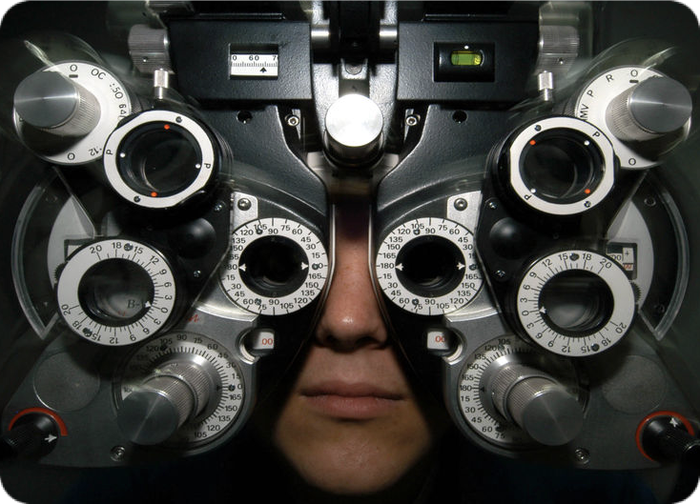
Distributional Hypothesis
If we consider optometrist and eye-doctor we find that, as our corpus of utterances grows, these two occur in almost the same environments. In contrast, there are many sentence environments in which optometrist occurs but lawyer does not...
It is a question of the relative frequency of such environments, and of what we will obtain if we ask an informant to substitute any word he wishes for oculist (not asking what words have the same meaning).
These and similar tests all measure the probability of particular environments occurring with particular elements... If A and B have almost identical environments we say that they are synonyms.
–Zellig Harris (1954)
Notes:
Similar messages expressed by Wittgenstein (1953) and Firth (1957) who said “You shall know a word by the company it keeps.”
VSMs are interesting especially due to their relation with the distributional hypothesis and related hypotheses. The distributional hypothesis is that words that occur in similar contexts tend to have similar meanings. Efforts to apply this abstract hypothesis to concrete algorithms for measuring the similarity of meaning often lead to vectors, matrices, and higher-order tensors.

Slide 16
Information Retrieval
Vector Space Models were initially developed in the SMART information retrieval system (Salton, 1971)
Each document in a collection is represented as point in a space (a vector in a vector space)
A user’s query is a pseudo-document and is represented as a point in the same space as the documents
Perform IR by retrieving documents whose vectors are close together in this space to the query vector
Notes:
SMART pioneered many of the concepts that are used in modern search engines
The idea of vector space models stems from Information Retrieval (IR) where instead of representing words as points in space, we represent documents as points in space, and a query can be represented as a point in the same space as the documents (the query is a pseudo- document). Then we return a sorted list of documents, starting with the document that is closest in space to the query.

Slide 17
Term-Document Matrix
 | D1 | D2 | D3 | D4 | D5
abandon
abdicate
abhor
academic
…
zygodactyl
zymurgy
Notes:
Documents can be things like Shakespeare’s plays, or novels, or web pages

Slide 18


Term-Document Matrix
 | D1 | D2 | D3 | D4 | D5
abandon
abdicate
abhor
academic
…
zygodactyl
zymurgy
Each column vector
represents a Document
Notes:
Documents can be things like Shakespeare’s plays, or Wikipedia pages, or IMDB reviews for a movie.

Slide 19
Term-Document Matrix
 | D1 | D2 | D3 | D4 | D5
abandon
abdicate
abhor
academic
…
zygodactyl
zymurgy
Each row vector
represents a Term

Slide 20


Term-Document Matrix
 | D1 | D2 | D3 | D4 | D5
abandon
abdicate |  | 3
abhor
academic
…
zygodactyl
zymurgy
The value in a cell is
based on how often that term
occurred in that document

Slide 21

Term-Document Matrix
}
 | D1 | D2 | D3 | D4 | D5
abandon
abdicate
abhor
academic
…
zygodactyl
zymurgy
The length of the
document vectors
is the size of the vocabulary

Slide 22
Term-Document Matrix
 | D1 | D2 | D3 | D4 | D5
abandon |  | 0
abdicate |  | 3
abhor |  | 0
academic |  | 0
… |  | …
zygodactyl |  | 0
zymurgy |  | 0
Document vectors
can be sparse
(most values are 0)

Slide 23


Term-Document Matrix
 | D1 | D2 | D3 | D4 | D5
abandon
abdicate
abhor
academic
…
zygodactyl
zymurgy
We can measure
how similar two
documents are
by comparing their
column vectors

Slide 24
What can document similarity let you do?
Notes:
Ask this question of students, write down their answers. Here are some:
Authorship attribution
Plagiarism detection
Document de-duplication
Compare documents by "tone"
IR where query = document

Slide 25
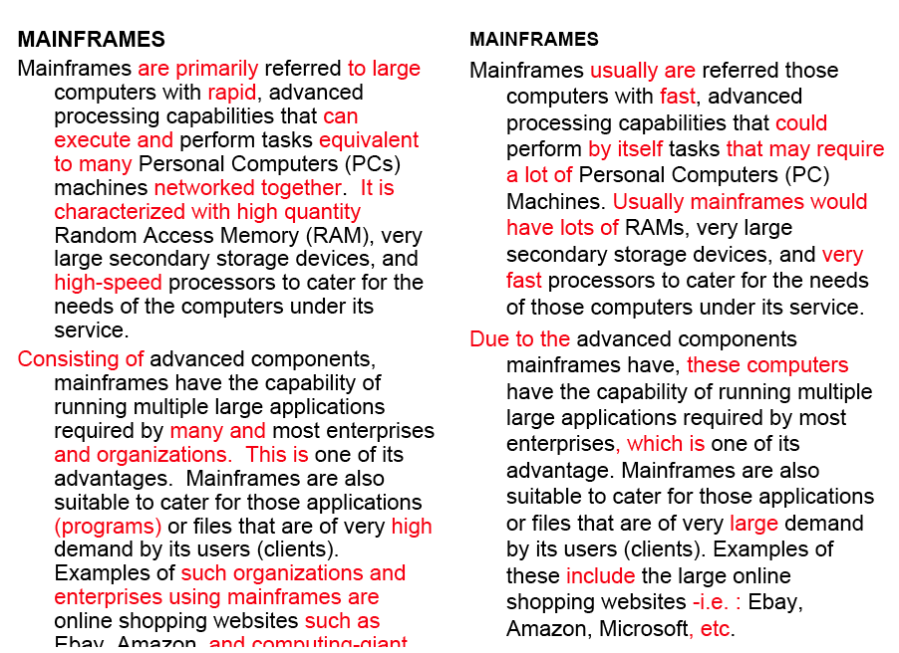
Word similarity for plagiarism detection

Slide 26



Term-Document Matrix
 | D1 | D2 | D3 | D4 | D5
abandon
abdicate
abhor
academic
…
zygodactyl
zymurgy
What does comparing
two row vectors do?
Notes:
It measures the similarity between words!

Slide 27
Vector comparisons
 | docX | docY
A | 2 | 4
B | 10 | 15
C | 14 | 10
Notes:
docY is a positive movie review
docx is a less positive movie review
A = "superb" positive / low frequency
B = "good" positive / high frequency
C = "disappointing" negative / high frequency

Slide 28
Vector comparisons
 | docX | docY
A | 2 | 4
B | 10 | 15
C | 14 | 10
docY is a positive movie review
docx is a less positive movie review
A = "superb" positive / low frequency
B = "good" positive / high frequency
C = "disappointing" negative / high frequency
Notes:
docY is a positive movie review
docx is a less positive movie review
A = "superb" positive / low frequency
B = "good" positive / high frequency
C = "disappointing" negative / high frequency

Slide 29
Vector comparisons
 | docX | docY
A | 2 | 4
B | 10 | 15
C | 14 | 10
Notes:
Euclidean distance : vectors u, v of dimension N
sqrt (sum_i to N ( | ui - vi|² ) )
A to B is sqrt of | 2-10 |² + | 4-15 |² = 13.6
B to C is sqrt of | 10-14 |² + | 15-10 |² = 6.4
A = Superb, B = Good, C=Disappointing
Goal: related words are close, and unrelated words are far apart.
Did we do it?

Slide 30
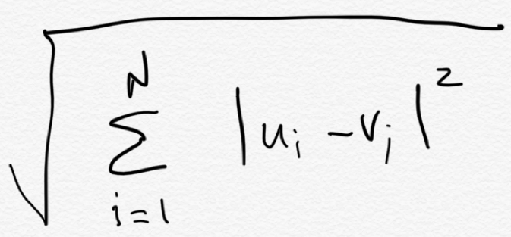
Vector comparisons
Euclidean distance
 | docX | docY
A | 2 | 4
B | 10 | 15
C | 14 | 10
B
distance = 6.4
distance = 13.6
C
Euclidean distance : vectors u, v of dimension N
A

Slide 31
Vector comparisons
Euclidean distance
 | docX | docY
A | 2 | 4
B | 10 | 15
C | 14 | 10
B = Good
distance = 6.4
distance = 13.6
C = Disappointing
Oh no! Good is
closer to Disappointing
than to Superb.
Euclidean distance : vectors u, v of dimension N
A = Superb

Slide 32
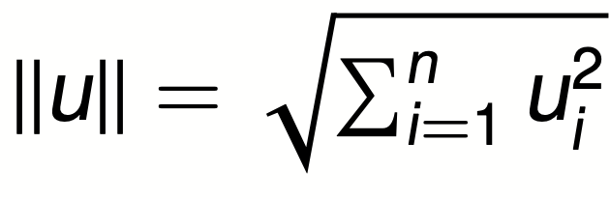
Vector L2 (length) Normalization
 | docX | docY
A | 2 | 4
B | 10 | 15
C | 14 | 10
||u||
4.47
18.02
17.20

Slide 33
Vector L2 (length) Normalization
 | docX | docY
A | 2/4.47 | 4/4.47
B | 10/18.02 | 15/18.02
C | 14/17.2 | 10/17.2
||u||
4.47
18.02
17.20
Divide each vector by its L2 length

Slide 34
Vector comparisons
 | docX | docY
A | 2 | 4
B | 10 | 15
C | 14 | 10
Notes:
Euclidean distance : vectors u, v of dimension N
sqrt (sum_i to N ( | ui - vi|² ) )
A to B is sqrt of | 2-10 |² + | 4-15 |² = 13.6
B to C is sqrt of | 10-14 |² + | 15-10 |² = 6.4
A = Superb, B = Good, C=Disappointing
Goal: related words are close, and unrelated words are far apart.
Did we do it?

Slide 35
Vector L2 (length) Normalization
 | docX | docY
Ȧ | 0.45 | 0.89
Ḃ | 0.55 | 0.83
Ċ | 0.81 | 0.58
A = Superb
B = Good
C = Disappointing
Now Good is
closer to Superb
than to Disappointing

Slide 36
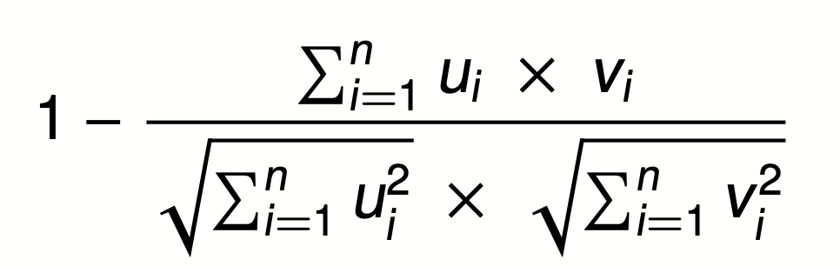

Cosine Distance
A = Superb
B = Good
C = Disappointing
Cosine does the L2
normalization too
Cosine angle between
vectors tells us their similarity

Slide 37
Term-Term Matrix
 | abandon | abdicate | abhor | … | zymurgy
abandon
abdicate
abhor
academic
…
zygodactyl
zymurgy
Notes:
Defines a co-occurrence matrix
w-2, w-1 target word w+1 w+2

Slide 38
Term-Term Matrix
AKA Term-Context Matrix
 | abandon | abdicate | abhor | … | zymurgy
abandon
abdicate
abhor
academic
…
zygodactyl
zymurgy
Length of the vector is now |V|
instead of number of documents
Notes:
|V| = size of vocabulary

Slide 39
Term-Term Matrix
AKA Term-Context Matrix
 | abandon | abdicate | abhor | … | zymurgy
abandon
abdicate
abhor
academic
…
zygodactyl
zymurgy
The value in a cell indicates how
often abandon appears in a
context window surrounding
abdicate
Notes:
Defines a co-occurrence matrix
w-2, w-1 target word w+1 w+2

Slide 40
Context windows
w-2, w-1 target_word w+1 w+2
The government most not abdicate responsibility to non-elected
it has led men to abdicate their family responsibilities
other demands, but declining to abdicate his responsibility
leaders abdicate their role and present people with no plans
 | his | leaders | not | responsibility | to
abandon | 1 | 1 | 1 | 2 | 3
Notes:
Defines a co-occurrence matrix
w-2, w-1 target word w+1 w+2

Slide 41
Context windows
Occur in a window of +/- 2 words, in the same sentence, in the same document
Instead of window of words use more complex contexts: dependency patters. Subj-of-verb, adj-mod, obj-of-verb
Languages have long distance dependencies The pictures are beautiful. The pictures of the old man are beautiful. The pictures of the old man holding his grandchild are beautiful.
Notes:
Defines a co-occurrence matrix
w-2, w-1 target word w+1 w+2

Slide 42
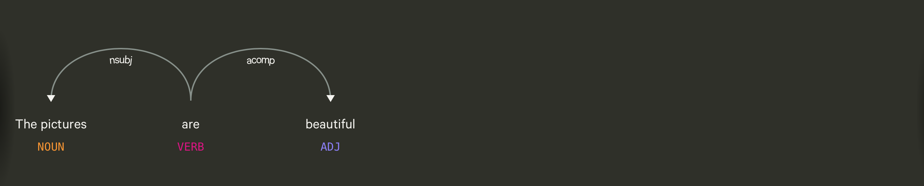
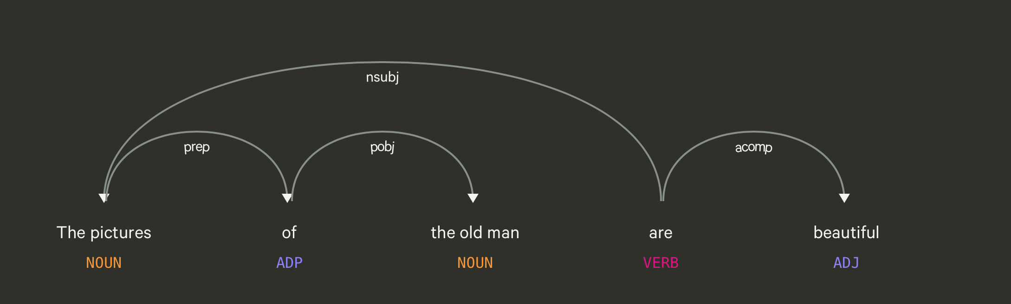
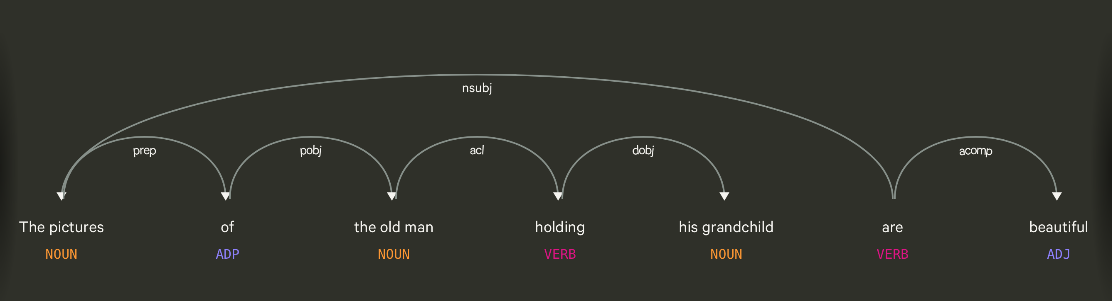

Slide 43
Using syntax to define a word’s context
Zellig Harris (1968) “The meaning of entities, and the meaning of grammatical relations among them, is related to the restriction of combinations of these entities relative to other entities”
Duty and Responsibility have similar syntactic distributions
Modified by adjectives | additional, administrative, assumed, collective, congressional, constitutional …
Object of verbs | assert, assign, assume, attend to, avoid, become, breach..

Slide 44
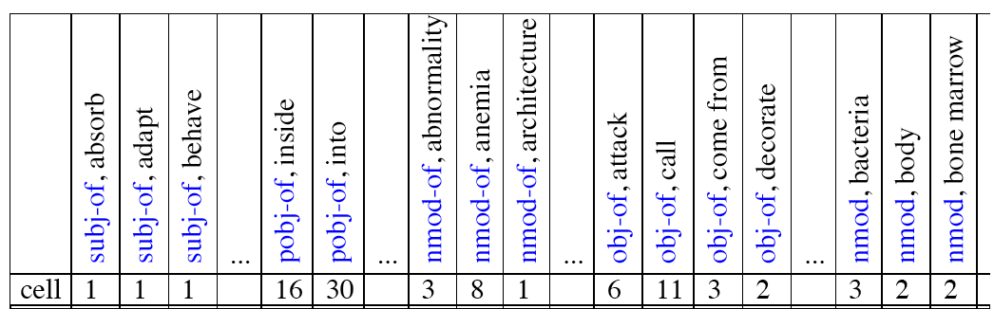
Co-occurrence vectors based on syntactic dependencies
Dekang Lin, 1998 “Automatic Retrieval and Clustering of Similar Words”

Slide 45
Alternates to counts
Raw word frequency is not a great measure of association between words. It’s very skewed “the” and “of” are very frequent, but maybe not the most discriminative
We’d rather have a measure that asks whether a context word is particularly informative about the target word.
Instead of raw counts, it’s common to transform vectors using TF-IDF or PPMI
Notes:
I’m going to skip the definition of PPMI for this talk

Slide 46


TF-IDF
Term frequency * inverse document frequency
1 over the number
of documents that it
occurred in
How often a
word occurred in
a document
Notes:
What does this do to a word like the?

Slide 47
Sparse v. Dense Vectors
Co-occurrence matrix (weighted by TF-IDF or mutual information)
Long (length |V| = 50,000+)
Sparse (most elements are zeros)
Alternative: learn vectors that are
Short (length 200-1000)
Dense (most elements are non-zero)
Notes:
ccb - future todo - Re-work as a visual?

Slide 48
Sparse v. Dense Vectors
Why dense vectors? Short vectors may be easier to use as features in machine learning (fewer weights to tune)
Dense vectors may generalize better than storing explicit counts
Neural networks produce dense vectors as output from their final hidden layer. These "word embeddings" are very popular at the moment

Slide 49
Skip-grams, CBOW
Mikolov et al. 2013
Learn embeddings as part of the process of word prediction.
Train a neural network to predict neighboring words
Inspired by neural net language models.
In so doing, learn dense embeddings for the words in the training corpus.
Advantages:
Fast, easy to train (much faster than SVD)
Available online in the word2vec package
Including sets of pretrained embeddings!

Slide 50
Skip-Grams
Predict each neighboring word in a context window of 2C of surrounding words
So for C=2, we are given a word wt and we try to predict its 4 surrounding words
[wt-2, wt-1, wt+1, wt+2]
Uses "negative sampling" for training

Slide 51
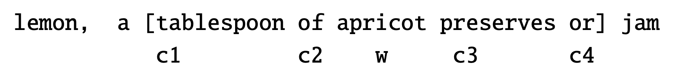

Negative sampling
We want predictions
of these words to be high
And these words to be low

Slide 52
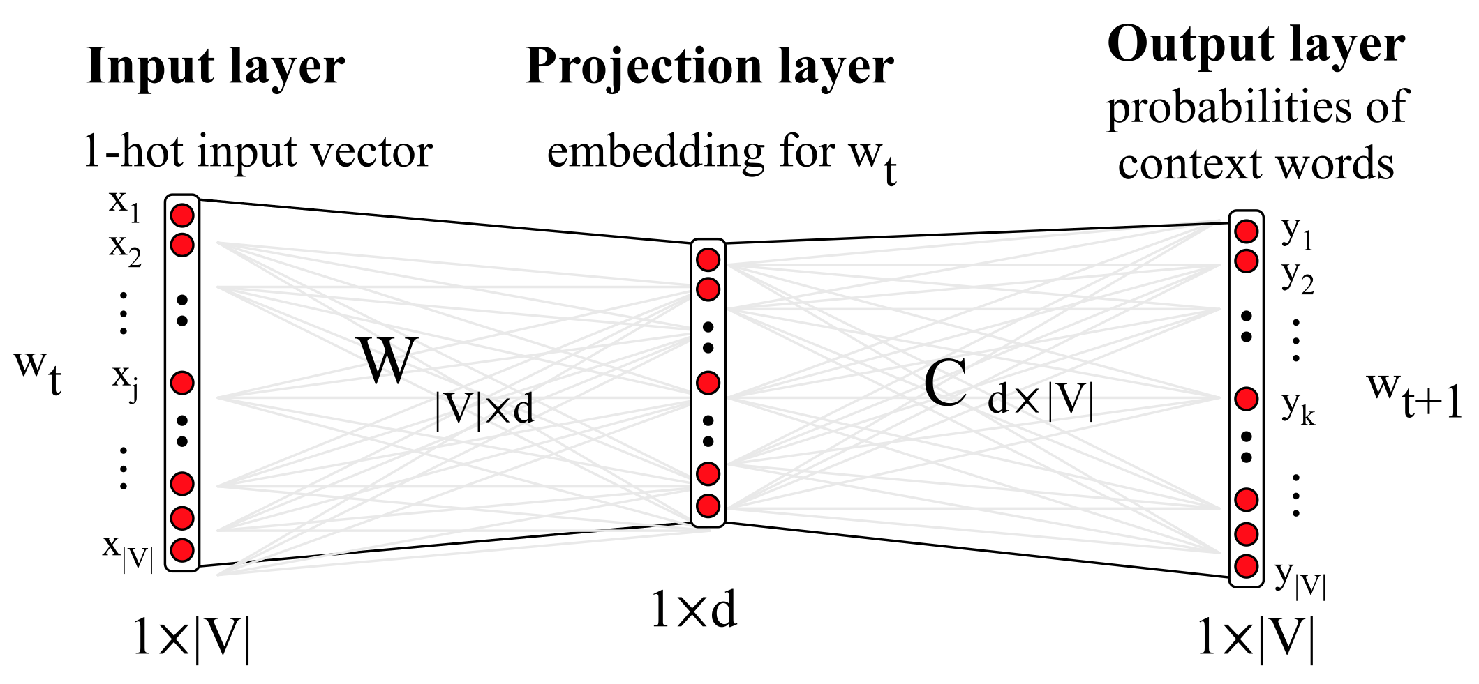
Neural Network

Slide 53
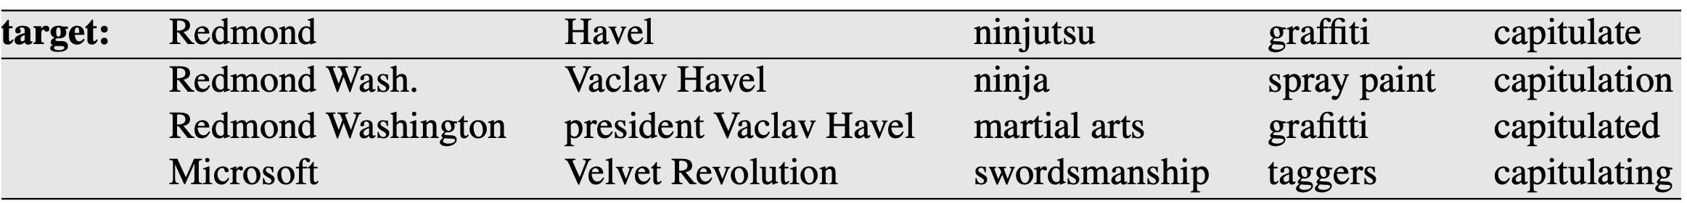
Properties of Embeddings
Nearest Neighbors are surprisingly good

Slide 54
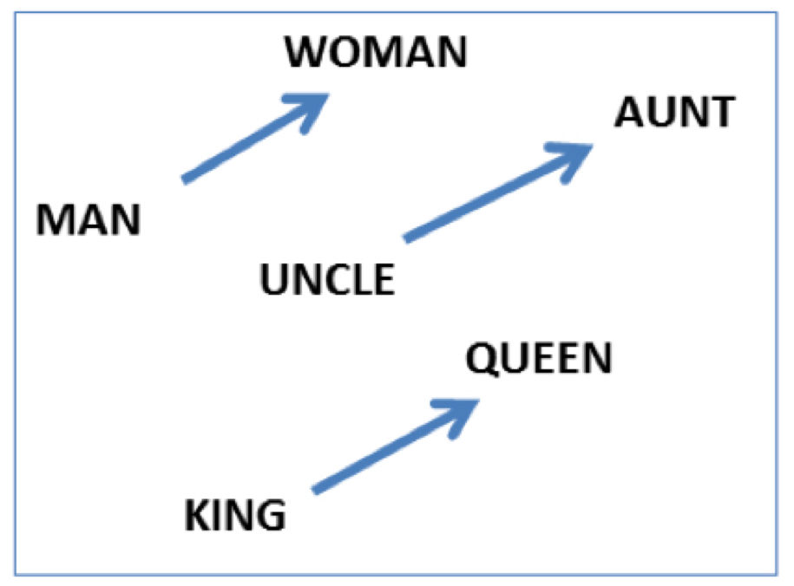
Embeddings capture relational meanings
.vector('king') - vector('man') + vector('queen') ≅ vector('woman')

Slide 55
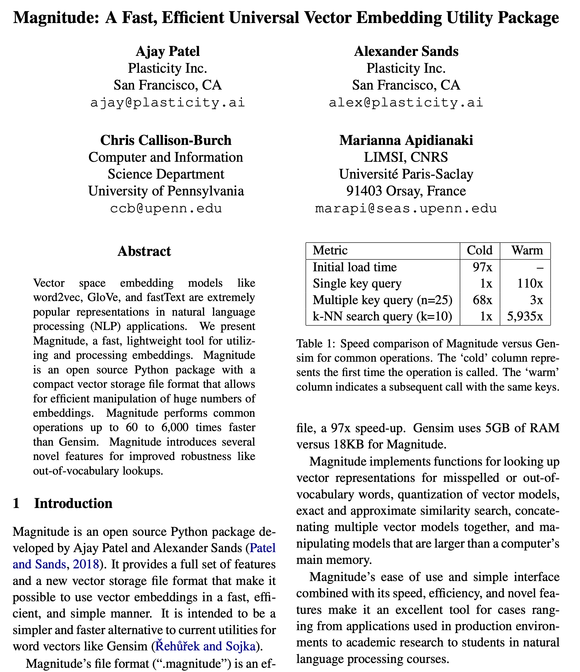

Slide 56
Demo of word vectors
# Install Magnitude
pip3 install pymagnitude
# Download Google’s word2vec vectors
wget http://magnitude.plasticity.ai/word2vec+approx/GoogleNews-vectors-negative300.magnitude
# Warning it’s 11GB large
# Start Python, and try the commands
# on the next slide
python3

Slide 57
Demo of word vectors
from pymagnitude import *
vectors = Magnitude("GoogleNews-vectors-negative300-2.magnitude")
queen = vectors.query('queen')
king = vectors.query("king")
vectors.similarity(king, queen)
# 0.6510958
vectors.most_similar_approx(king, topn=5)
#[('king', 1.0), ('kings', 0.72), ('prince', 0.62), ('sultan', 0.59), ('ruler', 0.58)]

Slide 58
Many possible models
Matrix type
Term-document
Term-context
Pattern-pair
Reweighting
length norm.
TF-IDF
PPMI
probabilities
Comparisons
cosine
Manhattan
Jaccard
KL divergence
JS distance
DICE
Dim. Reduction
word2vec
GloVe
PCA
LDA
LSA

Slide 59
Many possible models
Matrix type
Term-document
Term-context
Pattern-pair
Reweighting
length norm.
TF-IDF
PPMI
probabilities
Comparisons
cosine
Manhattan
Jaccard
KL divergence
JS distance
DICE
Dim. Reduction
word2vec
GloVe
PCA
LDA
LSA
How many dimensions?
What modifications should we make to the input?
Notes:
Modifications: tokenization/normalization, annotation/tagger, parsing, cluster text by author/time/etc.

Slide 60
How do we pick the right combination?
Notes:
Ask students.
Trial and error?

Slide 61
Evaluating word vectors
2 kinds of evaluation:
1) Extrinsic evaluation = task based
2) Intrinsic
Notes:
Ask students.
Trial and error?

Slide 62
Psycholinguistics Data
Cos sim | U | V | Judgements
… | Love | Sex | 6.8
 | Tiger | Cat | 7.3
 | Tiger | Tiger | 10
 | Fertility | Egg | 6.7
 | Stock | Egg | 1.8
 | Professor | Cucumber | 0.3

Slide 63
Computing correlation
Human ordering
Love | Sex
>
Professor | Cucumber
System ordering predicts
< … this is a discordant pair
> … this is a concordant pair
Notes:
range -1 to 1

Slide 64
Does similarity == semantics?
Word vectors fail to capture logical implications Dog(x) → Animal(x) Dog(x) → not (Gorilla(x))
Word vectors for antonyms or logically exclusive things are often very similar sim(boys, girls) sim(cats, dogs) sim(France, Germany) sim(rise, fall)

Slide 65
Acknowledgements
Thanks to the following people for providing slides
Dan Jurafsky from his textbook Speech and Language Processing version 3
Peter Turney and Patrick Pantel From Frequency to Meaning: Vector Space Models of Semantics
Chris Potts from his course CS224U: Natural Language Understanding
Denis Paperno, Marco Baroni, German Kruszewski from their talk on Deriving Boolean Structures from Distributional Vectors

